Slide 1

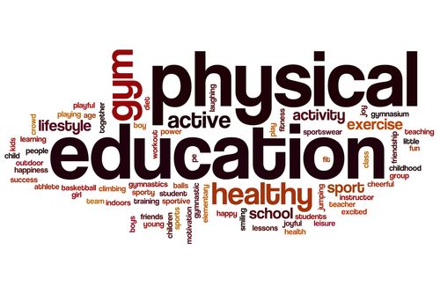

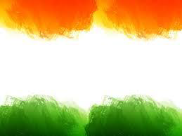
SHRI GURU GOBIND SINGH JI GOVT. COLLEGE,
PAONTA SAHIB, SIRMOUR (H.P)

Slide 2

B.A. 2nd YEAR
COURSE NAME: SPORTS MEDICINE PHYSIOTHERAPY AND REHABILITATION
COURSE CODE: PED203TH

Slide 3

FIRST AID

Slide 4
TOPICS TO BE COVERED
MEANING OF SPORTS MEDICINE
MEANING OF FIRST AID
DEFINITION
BASIC PRINCIPLES OF FIRST AID
MAIN PRINCIPLES OF FIRST AID

Slide 5
MEANING OF SPORTS MEDICINE
Sports medicine is a branch of medicine that deals with physical fitness and the treatment and prevention of injuries related to sports and exercise.
Sports medicine is not just for professional athletes.

Slide 6
MEANING OF FIRST AID
First aid is the first and immediate assistance given to any person with either a minor or serious illness or injury, with care provided to preserve life, prevent the condition from worsening, or to promote recovery.

Slide 7
DEFINITION
When you provide basic medical care to someone experiencing a sudden injury or illness, it’s known as first aid.
In some cases, first aid consists of the initial support provided to someone in the middle of a medical emergency.
This support might help them survive until professional help arrives.
In other cases, first aid consists of the care provided to someone with a minor injury. For example, first aid is often all that’s needed to treat minor burns, cuts, and insect stings.

Slide 8
BASIC PRINCIPLES OF FIRST AID
ABCs of First AidIf someone is unconscious or unresponsive, the basic principle of first aid that you need to know is ABC: airway, breathing, and circulation.
Airway: If someone’s not breathing, the first thing you need to do is clear their airway.
Breathing: If you have cleared a person’s airway but they’re still not breathing, provide rescue breathing.
Circulation: As you are doing rescue breathing, perform chest compressions to keep the person’s blood circulating. If the person is breathing but is not responsive, check their pulse. If their heart has stopped, provide chest compressions.

Slide 9
MAIN PRINCIPLES OF FIRST AID
PRESERVE LIFE
The first aim of first aid is to preserve life, which involves the key emergency practices to ensure that the casualty isn’t in any mortal danger. Remember though, this includes preserving your own life as you shouldn’t put yourself in danger in order to apply first aid. Its at this stage where you should do a quick risk assessment to check for dangers to the injured person, yourself or bystanders which could cause the situation to escalate. If in doubt, do not attempt to apply first aid and immediately call for a medical professional.
PREVENT DETERIORATION
Once you’ve followed all the steps associated with the first principle, your next priority is to prevent deterioration of the injured person’s condition. Keeping a casualty still to avoid aggravating their injury, or from complicating any unseen issues, is crucial. This helps prevent to further injuries, and clearing the area of any immediate dangers will help you to do so.

Slide 10
PROMOTE RECOVERY
Finally, there are steps you should follow which will help lessen the amount of time taken for a casualty to recover from an accident and aid in minimising lasting damage and scarring. The prime example of this is applying cold water to a burn as soon as possible to lower the chance of long-term scarring and helps speed up the healing process.
TAKING IMMEDIATE ACTION
This is the key to the ‘Preserving Life’ principle – a quick response to an accident can save lives and minimise the risk that things get worse. If someone needs help, either from an injury or sickness, you shouldn’t hesitate to help if possible.

Slide 11
CALMING DOWN THE SITUATION
First aiders should be able to remain calm under pressure and help reduce the overall stress levels of the injured person as well as other people who may be concerned. Reassurance can provide more support that you might expect in an emergency situation and help people make the right decisions.
Calling for medical assistance
Make sure to get a hold of the emergency services by calling 999 as soon as possible, either by calling directly yourself or asking a bystander to do so if you’re preoccupied handing the injury. This will ensure that a medical professional arrives quickly to handle the situation in a more comprehensive manner and provide more specialist treatment.

Slide 12
APPLY THE RELEVANT TREATMENT
Before a medical professional does arrive, you will need to apply first aid treatments in order to stabilise the condition of the injured person. This comes under the ‘preserve life’ banner, and follows this flow of procedures:
  Check for consciousness
  Open the airway
  Check for breathing
  Follow airway, breathing, of resuscitation, administer CPR if needed
  Check for circulationCheck for bleeding, controlling any major bleeding

Slide 13


